Slide 1



Day 01
contact@anubhavtrainings.com
ABAP RESTFUL APPLICATION PROGRAMMING

Slide 2

Introduction

Slide 3


Agenda – Day 01
Introduction
Introduction to this course
Development Tools – Eclipse and ADT
Business Application Studio
VS Code
Difference between On-premise and Cloud
Type of offerings
What is BTP
Using Eclipse Development Tool for ABAP Development
Create DB Tables using Eclipse
Load Sample Data to the demo Tables
Introduction to CDS Views Basics
Introduction to CDS entities
Describing AMDP with Use Case
Table function
Service Definition & Service Binding
Introduction to SAP Business Application Studio

Slide 4
What to expect ?
Phase 1
Learn the basics of CDS to advance concepts and understand the RAP
Phase 2
Complete RAP development on S/4HANA with Fiori Apps using Annotations and Elements
Phase 3
S/4HANA Embedded Analytics
Phase 4
Node JS and SAP UI5 tooling with VS Code

Slide 5
Pre-requisite
1
Experience on S/4HANA
1
Understand the S/4HANA and how it is different from ECC
2
2
UI5 and Fiori Development
Aware of UI5 app development lifecycle
3
Strong Programming Skills
4
Good programming skills on ABAP
3
4
Knowledge of SAP
Have prior experience on one of the SAP Area

Slide 6

Features of ADT ( ABAP Development Tool )
01
Go to link
02
Install Java = java –version to check if its already there Java 8: SAP JVM 8 , Java 11: SapMachine 11
01
VS Runtime - For Windows OS: Microsoft Visual C++ 2013 (x64)
04
Get an installation of Eclipse 2021-06
(e.g. Eclipse IDE for Java Developers)
05
In Eclipse, choose in the menu bar Help > Install New Software...
06
Enter the URL
https://tools.hana.ondemand.com/latest
07
Select ABAP Development Tools and choose Next.
08
On the next wizard page, you get an overview
of the features to be installed. Choose Next.
09
Confirm the license agreements and
choose Finish to start the installation.
www.anubhavtrainings.com

Slide 7
Features of ADT ( ABAP Development Tool )
FREE and open source
Work with multiple systems parallelly
Fully customizable dev environment
It has integration with SAPGUI Ctrl+6
Fast Search and navigation
Ctrl+Shift+A – Search any object
Ctrl + T – Base classes
Integration with Transport Org, ATC
ABAP Profiles
This is the future of ABAP development on HANA and S/4HANA and even ABAP on Cloud
Verity of development using single tool – ABAP, UI5, HANA Native, Java, NodeJS, Android
Quick fix
Design time check on syntax
Code completion Ctrl+Space
Pretty Printer Ctrl+Shift+F
Code templates
Increases developer efficiency
ABAP has got new syntax, which means my old code is not dead and it will not work - False
www.anubhavtrainings.com

Slide 8
Development Tools BAS and VS Code
Step 1: Install your dev tool
BAS – SAP Businesss Application Studio
Local
VSCode – Free tool provided by Microsoft
It gives thousands of plugins which we can install to make life of a developer easy.
https://code.visualstudio.com/download
Step 2: Install Node JS
Download and install node js - https://nodejs.org/en/
Test if its available
node -v
www.anubhavtrainings.com

Slide 9
Compare
Business Application Studio VS Code
Tool provided by SAP Directly but a modified version of VS Code
Multi-cloud development tool for SAP specific developments
Runs in cloud, open browser and run
Cannot run w/o connectivity
Productive version is costly
Initial setup was very easy
If the SAP BTP is down, we cant use BAS
Your project is in cloud so you can easily switch device
Backup is already on cloud
All the fiori tooling is pre-installed in dev space
https://www.sap.com/products/business-technology-platform/price-list/estimator-tool.html
Tool provided by Microsoft provided by Microsoft which is an open source
We can use for different technological developments, but in local machine
Runs on local machine
Does not need internet connectivity
Free
Initial setup was little difficult for beginner
We can use anytime
We need to manually take project if we do device switch
It is developers job to take the backup
We need to configure in our laptop

Slide 10
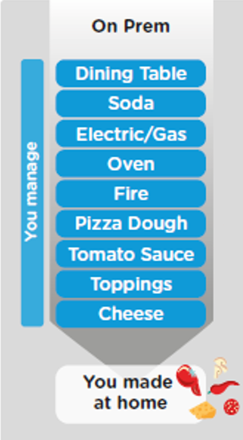
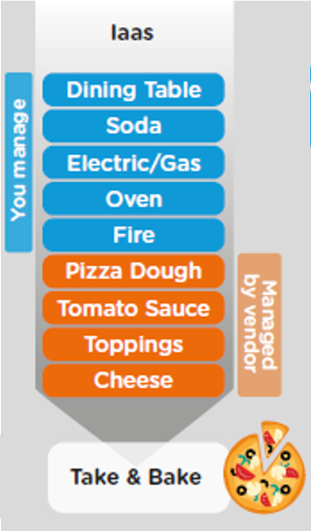
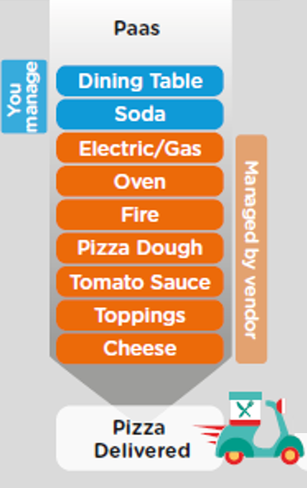
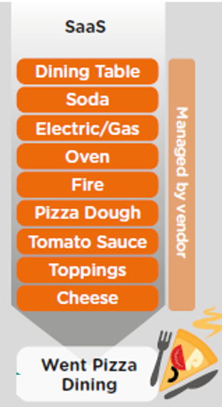
ON-PREMISE V/S CLOUD
www.anubhavtrainings.com

Slide 11
TYPE OF CLOUD OFFERINGS
Application
Application As a Service
Customer Managed
Customer Managed
Customer Managed
SAP Managed
Data
Runtime
Platform as a Service
SAP/Partner Managed
Middleware
Database
OS
Virtualization
Infrastructure as a Service
SAP/Partner Managed
Servers
Storage
Networking
www.anubhavtrainings.com

Slide 12
What is SAP BTP ?
SAP Business Technology Platform (SAP BTP) is the platform that powers you to become an intelligent enterprise through integration, extension, and data-to-value from all SAP and third-party application and data assets while ensuring your long-term success through agility, value-creation, and continual innovation.
BTP is an digital platform as a service to allow companies to build/integrate/extend existing solutions

Slide 13




WHAT IS SAP BTP?
Application
Application
Data
Data
Runtime
Platform as a Service
Managed by SAP implementing open source CF
Middleware
Fully ready landscape with reusable services
Scalability
Elasticity
Low TCO
Database
OS
Managed by Infrastructure
providers
Data Centers
Service Portfolio
Virtualization
Infrastructure as a Service
Servers
Storage
Networking
www.anubhavtrainings.com

Slide 14
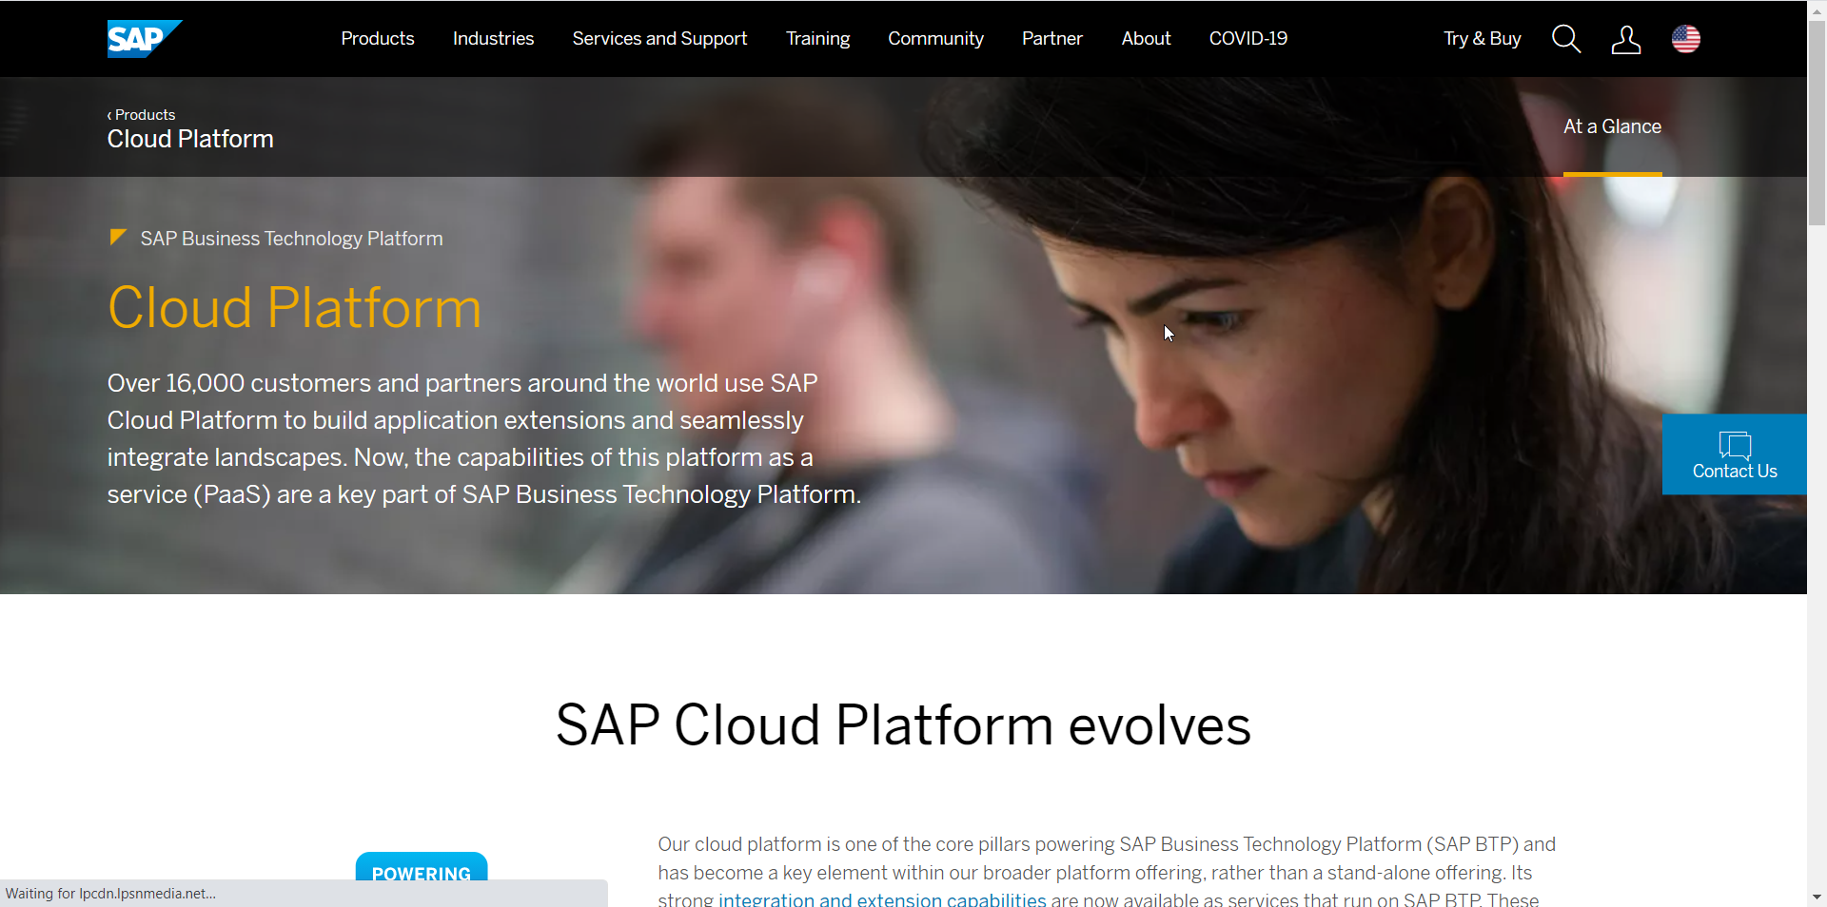
Setup Your FREE Account
https://account.hanatrial.ondemand.com/trial/#/home/trial
www.anubhavtrainings.com

Slide 15



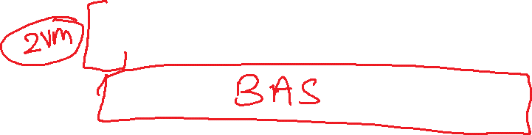





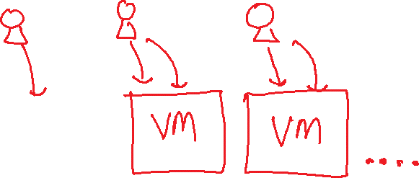



Slide 16
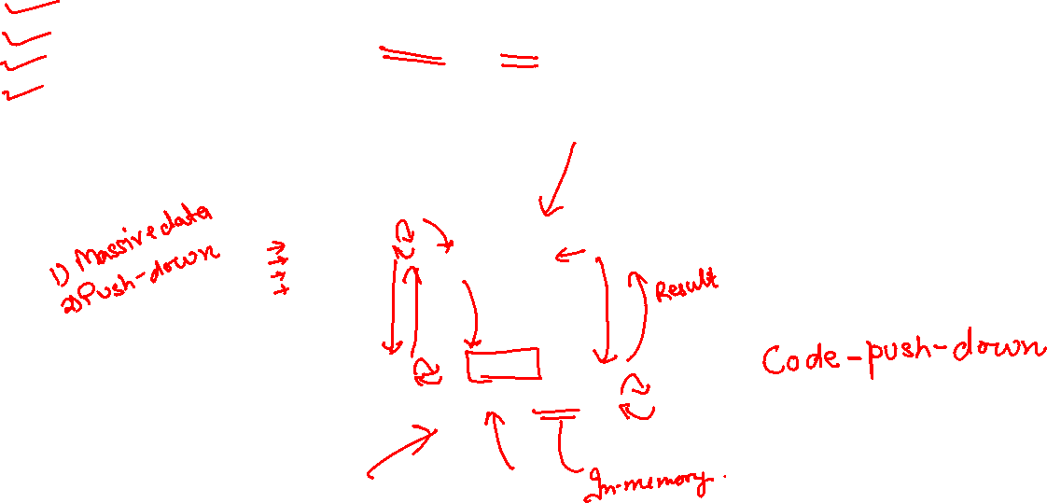
CDS – Core Data and Services
CDS is an extension of SQL in ABAP system. The main advantage of CDS is to achieve code-to-data paradigm. CDS is available for multiple purpose
DDL (data definition layer)
DQL (data query language) – CDS Views and CDS entities
DCL (data control language)
DEL (data expression language)
Fetch
Load
Loop
Process
Application
Fetch
Load
Loop
Process
Cds view
Database (HANA)
HANA view
www.anubhavtrainings.com

Slide 17
Create Your DB Tables
Business Partner
Sales Order Header
Sales Order Items
1..1
1..*
Product
1..1
Exercise
Create Data elements & Domain for ID (Char32) and Role (Char2)
Create Database Tables
Load Data to the table

Slide 18
Code To Data Paradigm
ABAP System
CDS Views
NW 7.4 SP6
Any DB
AMDP/Table Function
7.4SP6, 7.5
HANA DB
HANA Views
SQL Script procedure and function
www.anubhavtrainings.com

Slide 19
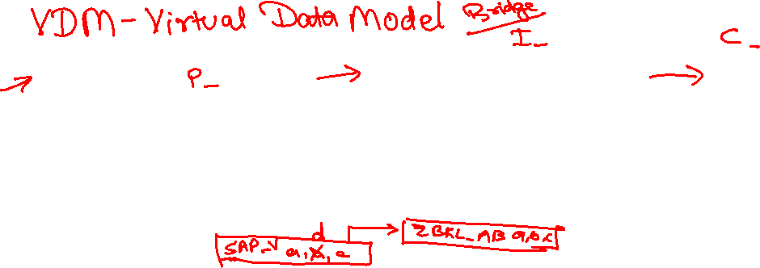
Why we need views in ANY SOFTWARE
Hide complexity – Imagine we have a ERP system, usually data in ERP is spread across MULTIPLE tables. Reading the data with Query becomes complex and error prone. We code VIEWS with all selections, conditions, and associations (joins). It provides data from functional point of view.
Security – We do not want to give direct access to DB tables, because tables are prone to attacks and security breach. Hence we create views, by masking (hiding), projections of the relevant data for the business use case. We additionally add ROW level security.
Modularization – We can develop complex functionalities by small size modules. Which calls and orchestrates between each other. It brings reusability and reduces redundancies.
In context of SAP CDS, we have annotations, framework consumptions, ease of development, support for tools, support for multiple use case, industry standard, inherent documentation.
Private views
Interface views
Consumption views
Developers only access to be used within other views, direct consumption should be prohibited.
Basic
Composite
Used for final consumption built on top of interface views.
They are reusable views can be consumed for any purpose, as they build a bridge between tables. Basic views are pure master, transaction data but composite views are combination of master and transaction data.
www.anubhavtrainings.com

Slide 20
Use Case
We want to develop a set of views which usages our custom data model to expose sales data for each customer and product.
Consumption 1
Total sales per customer
Composite
Total sales per product
https://help.sap.com/docs/BTP/5371047f1273405bb46725a417f95433/2d3a05e516374108b5881840267a13b2.html
Composite
Interface Sales
Interface Customers
Interface Products
I_Country
BusinessPartner
Sales Order Header
Sales Order Item
product
www.anubhavtrainings.com
I_Currency

Slide 21
Creating CDS View
ZATS_00_C_SOFTSALES
ZATS_00_I_BP
ZATS_00__I_SALES
ZATS_00_SO_I
0..1
ZATS_00_BP
0..1
ZATS_00_I_SALESHDR
ZATS_00_P_PROD
0..1
ZATS_00_SO
ZATS_00_Product
Exercise
Create CDS View According to VDM

Slide 22
CDS Entity
CDS entity is EXACTLY like CDS Views but with
optimized performance,
A single object for all purpose basically no more 3 names
No need to create DDIC view
The HANA view name will be same as CDS entity Name
Exceptions
CDS entities does not support BOPF integration
www.anubhavtrainings.com

Slide 23
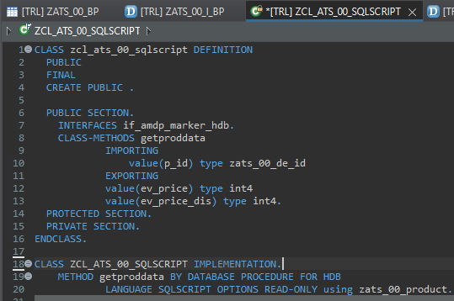
Describing AMDP
ABAP Managed Database Procedures (AMDP) are the preferred way for developing SAP HANA DB procedures on the ABAP platform. Since ABAP Managed Database Procedures are implemented as methods of a global ABAP class, the editing environment for AMDP is the ABAP class editor.
Requirement 1: Pass the product id, system should calculate the discounted price and return
actual and discounted price.
There are 2 types of SQL Script contains:-
Procedure - can have multiple return values
Function - always have one return value
Exercise
Create AMDP

Slide 24
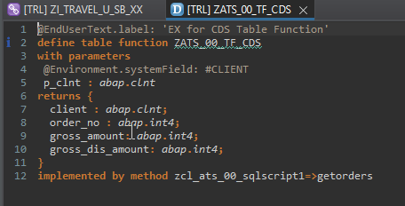
Creating Table Function
A CDS table function is defined using the ABAP CDS statement DEFINE TABLE FUNCTION and can be used as the data source in Open SQL read statements.
Each CDS table function includes the following components:
The actual CDS entity of the table function that is generated in the ABAP Dictionary
The CDS table function implementation (ABAP class library)
Requirement 2: return all the sales order no, amount (actual), discounted amount of sales orders]
Exercise
Create Table Function

Slide 25
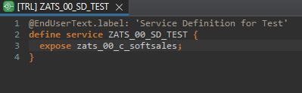
Service Definition
The service definition is a projection of the models and related behavior that you want to expose. In a service definition, you define the OData service to determine which CDS entities are part of the service. This service is then bound to a protocol and to either a UI technology or an A2X service by a service binding artifact. A service definition can be integrated in various protocols without any reimplementation.
Exercise
Service Definition

Slide 26
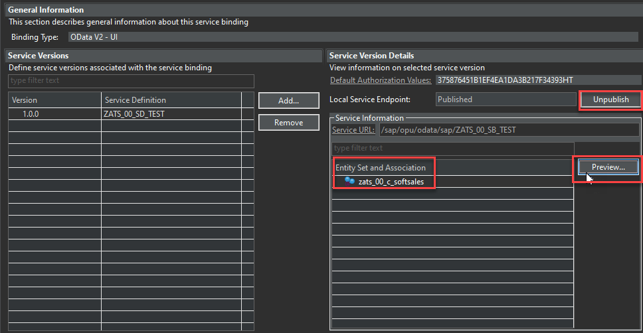
Service Binding
A service binding implements the protocol that is used for the OData service. It uses a service definition that projects the data models and their related behaviors to the service.

Slide 27
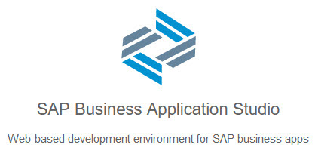
BAS Introduction
SAP Business Application Studio is a new SAP Business Technology Platform (BTP) service that offers a modern development environment tailored for efficient development of business applications for the SAP Intelligent Enterprise.
SAP Business Application Studio provides a tailor-made development environment for various development scenarios, such as SAP Fiori, SAP S/4HANA extension, and Workflow. With each of these scenarios, you can create different types of applications.
These tools cover the end-to-end development cycle:
Clone an existing project with a Git client or create new project using templates.
Use editors for SAP-specific technologies.
Easily test your application on your dev space while consuming services from remote sources.
Build and deploy the application as a multitarget application (MTA).

Slide 28
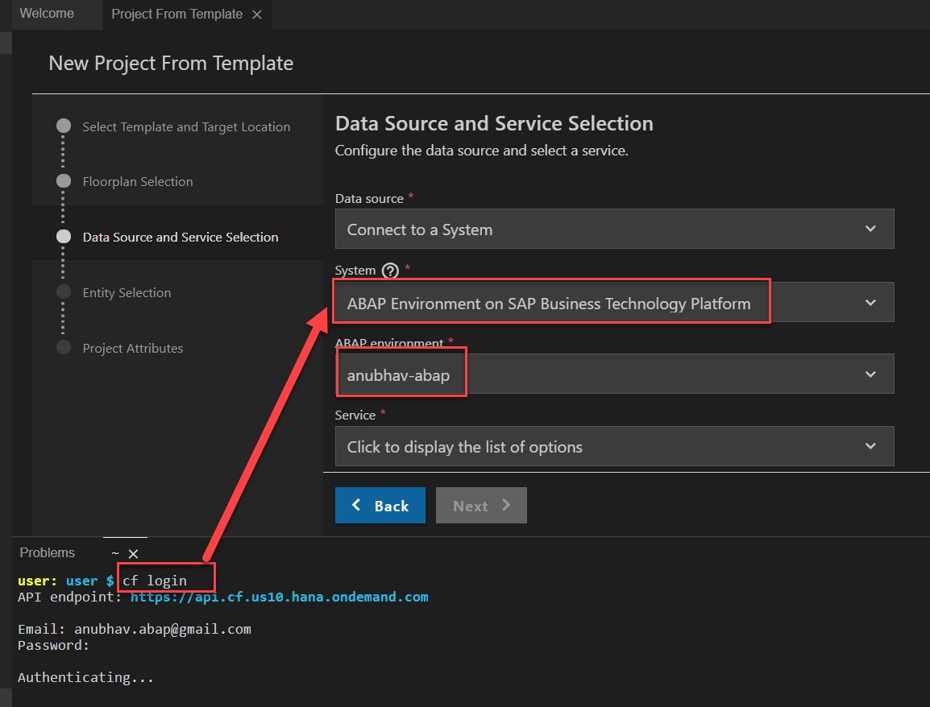
Creating Fiori App on BAS
Creating Fiori App on BAS Using Service on Top of CDS Model.
First Login Cloud Foundry ( cf login ).
Select System ABAP Environment on SAP BTP.

Slide 29

End of Day 01
Trainer: Anubhav Oberoy

Slide 30

Trainer: Anubhav Oberoy

Slide 31
THANK YOU
If you cannot do
great things, do small things in a great way.
Anubhav Oberoy
https://www.anubhavtrainings.com

Slide 32


We’re committed to empower you to be
Most Desirable Resource
through powerful training solutions.
We build the workforce of the future.
250+
Corporate Clients
30,000+
Learners Trained
25000+
Learners Placed
FREE WEBINARS
Sign up for free webinars with industry experts every fortnight!
Enroll Now!
Contact us today!
https://anubhavtrainings.com/

Slide 33




More from AnubhavTrainings.com

